Slide 1


ABHYAST
An Autonomous Navigation Vehicle for Surveillance
Abhilash Jindal | Ankur Jain
Faez Ahmed | Gaurav Dhama
Mayank Baranwal | Palash Soni
Shishir Pandya | Sriram Ganesan

Slide 2
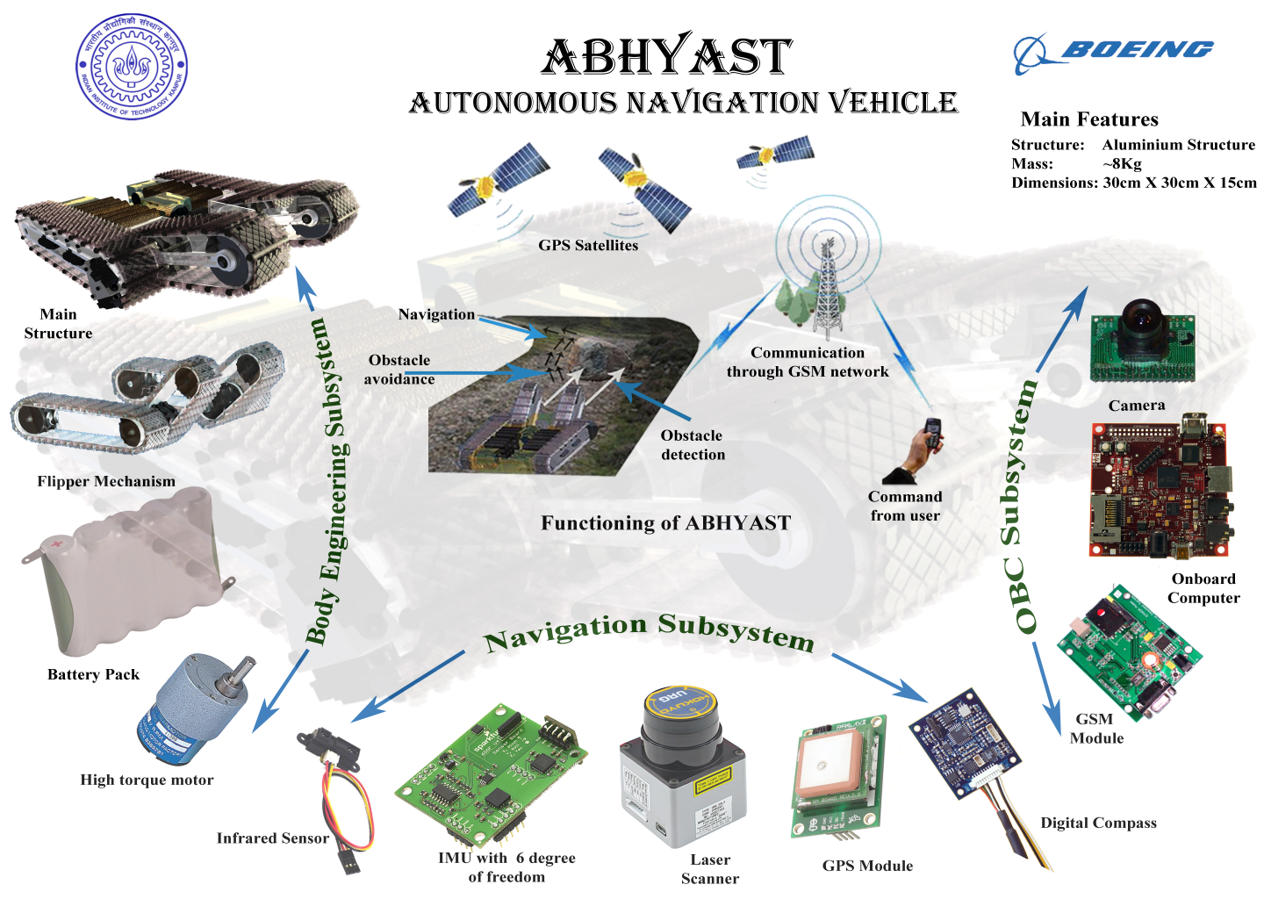

Slide 3
Description
ABHYAST accepts location coordinates in 3 formats:-
Short distance navigation(<100 mt)
Latitude/Longitude accepted
Displacement Vector accepted
Long Distance Navigation
Latitude/Longitude accepted
Locations name accepted and pre-stored map followed(in structured environment).
Uses GPS and Compass for Absolute Positioning and IMU and Proximity Sensors for relative short distance navigation.
Laser Scanner and IR sensors help in Obstacle detection, Collision avoidance and Path Planning in short term.
Camera used for imaging/video of target location and images stored in Memory.
Task completion communicated to User and Abhyast returns to original position or as commanded by user.

Slide 4
Body engineering

Slide 5
Design considerations
Terrain adaptation.
Physical space and weight of the vehicle.
Obstacle scaling mechanism.
Choice of Locomotion System.
Choice of Drive System.
Mechanical complexity.
Control complexity.

Slide 6
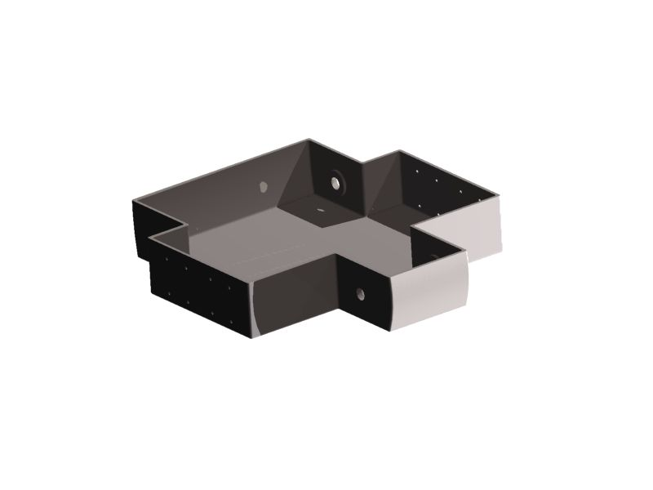
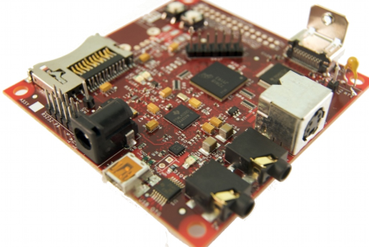
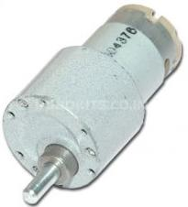
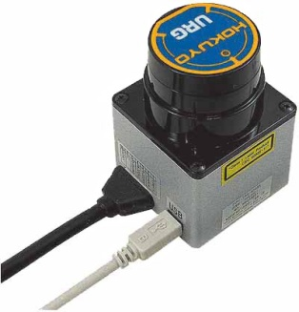
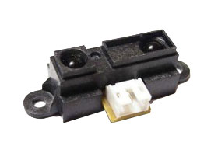
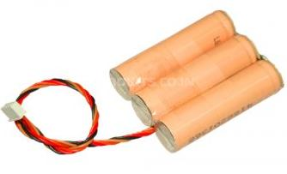
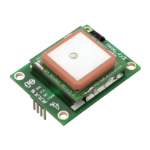
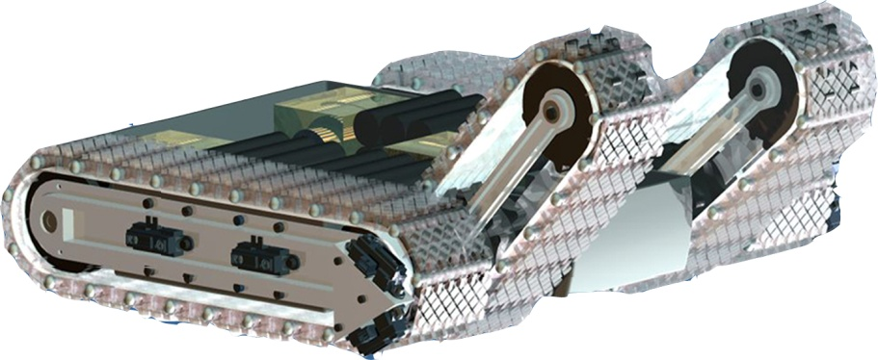
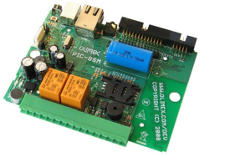
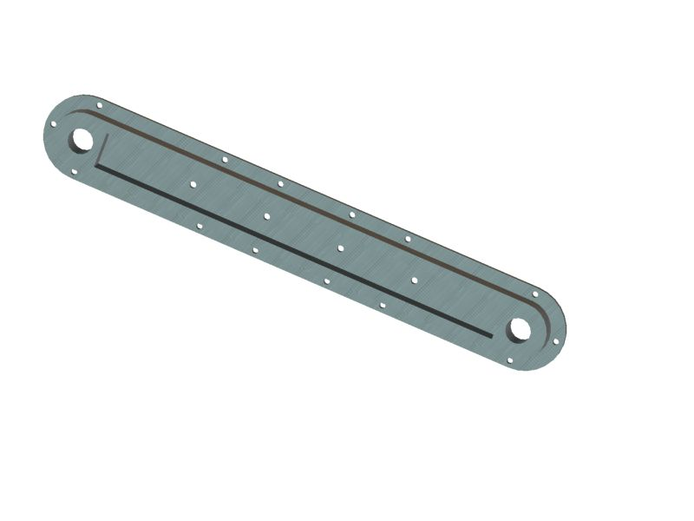
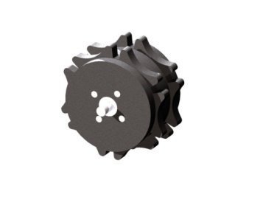
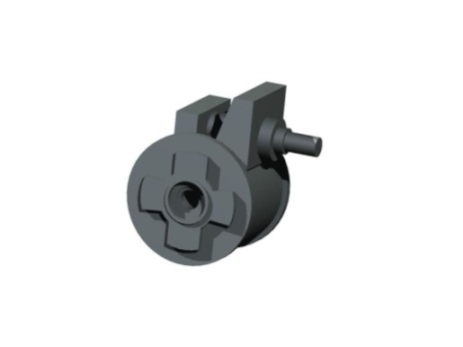
Body Engineering Overview
Motor
Chassis
Battery
Electronic components
Tracks
Support beam
Worm gear box
Sprocket

Slide 7
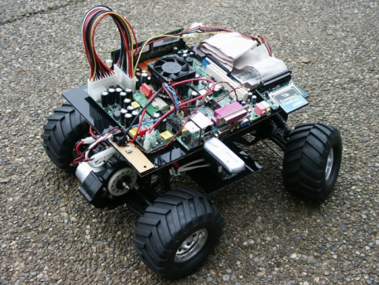
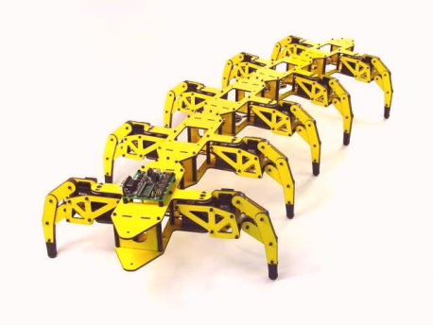
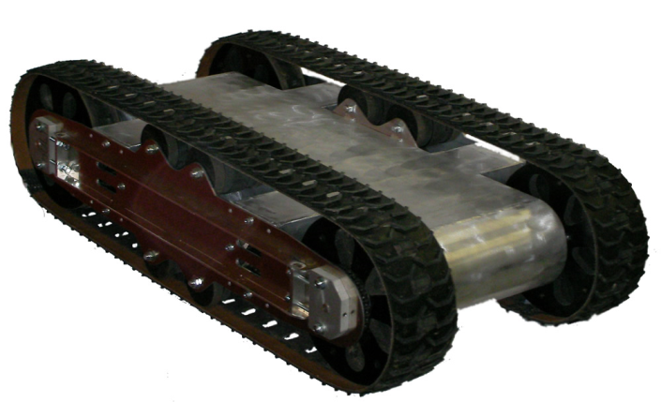
Choice of locomotion system
Tracked
Wheeled
Legged

Slide 8
Why tracks ?
Adapt to surface undulations.
Scale obstacles using Flipper Assist Mechanism.
Achieve good stability with its large ground contact area.
Turn in minimum space.
Requires slipping to turn.
Coupled speed and direction.
High frictional losses.

Slide 9
Passive double track mechanism
This mechanism gives passive adaptability based on a link structure.
Double track mechanism is composed of two tracks driven by a single motor for each side.
Passivity is acquired by attaching the flipper track with the main track through a hinge joint without an actuator.
hinge
motor
Flipper tracks
Main tracks

Slide 10
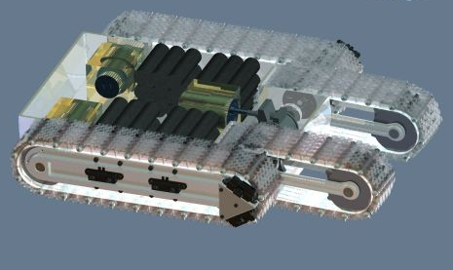
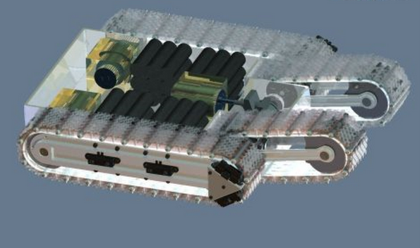
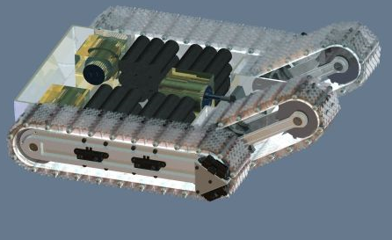
Flipper Assist mechanism
Flippers change orientation
to adapt to the terrain.
They help to scale obstacles.
Flippers oriented
parallel to the ground.
b. Flippers changing
orientation.
c. Flippers oriented at
required incline.

Slide 11
mechanism: an example Flipper assist
(1)
(2)
(3)
(4)
(5)
(6)

Slide 12
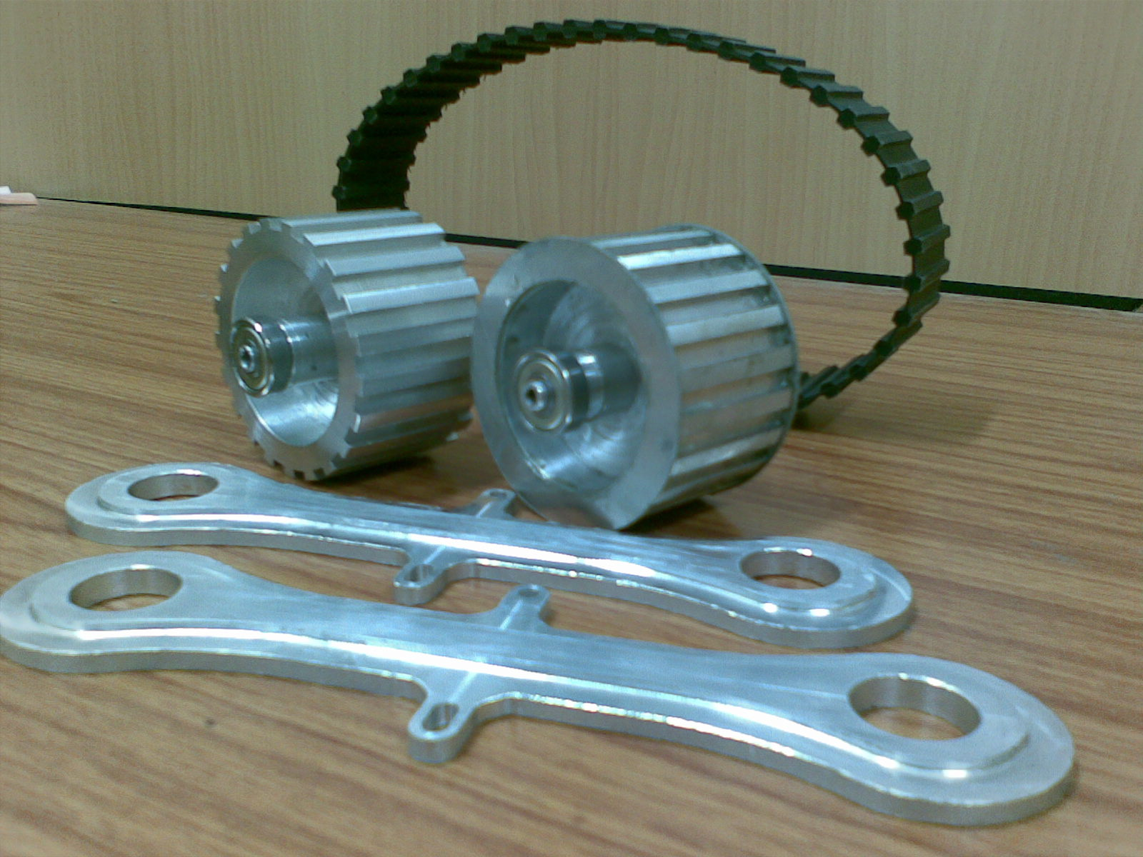
Aluminium Sprockets and support beams to keep both strength and a low weight.
Rubber tracks impregnated with metal fibres providing robustness and good traction.
The image depicts some parts of a flipper(auxiliary track).

Slide 13
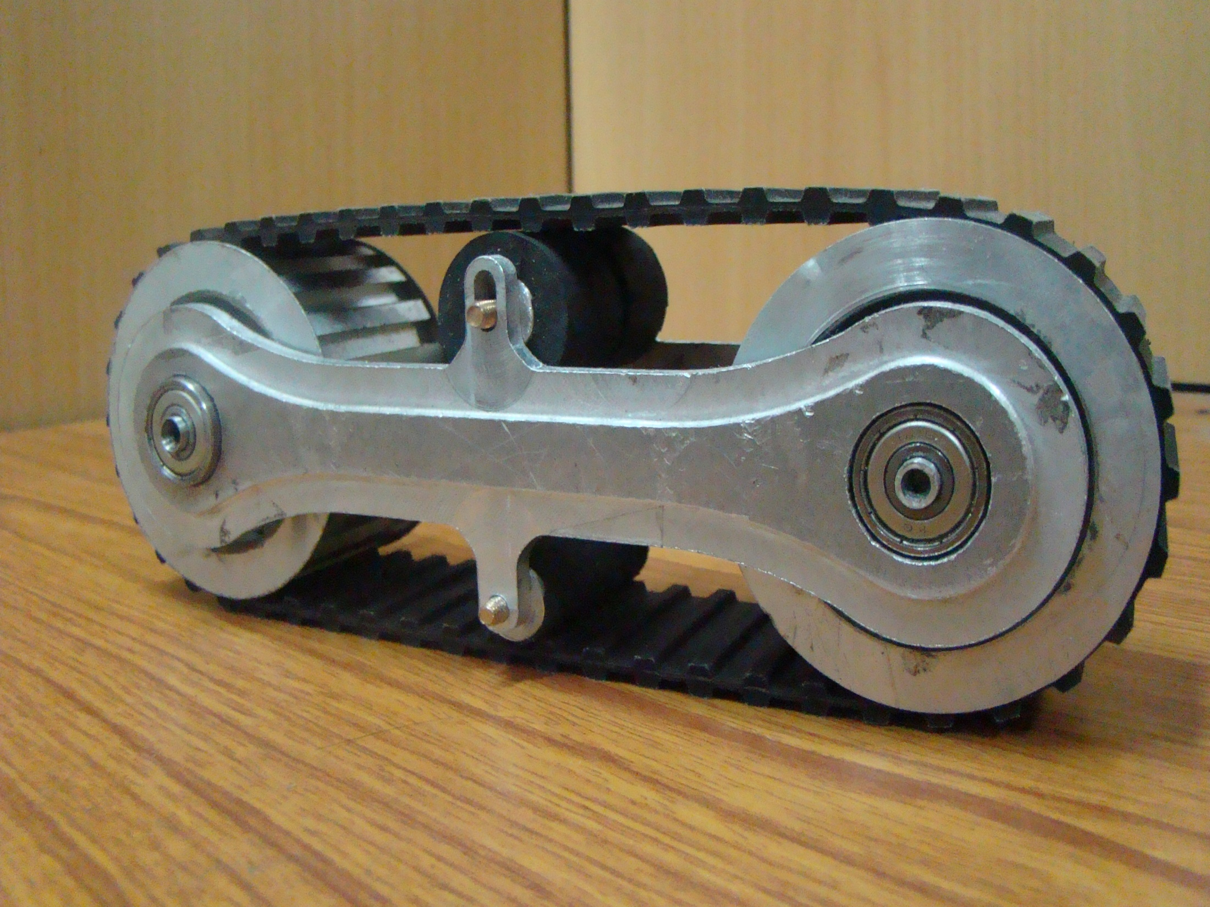
Passive rollers
Flipper Assembled
Aluminium Sprockets

Slide 14
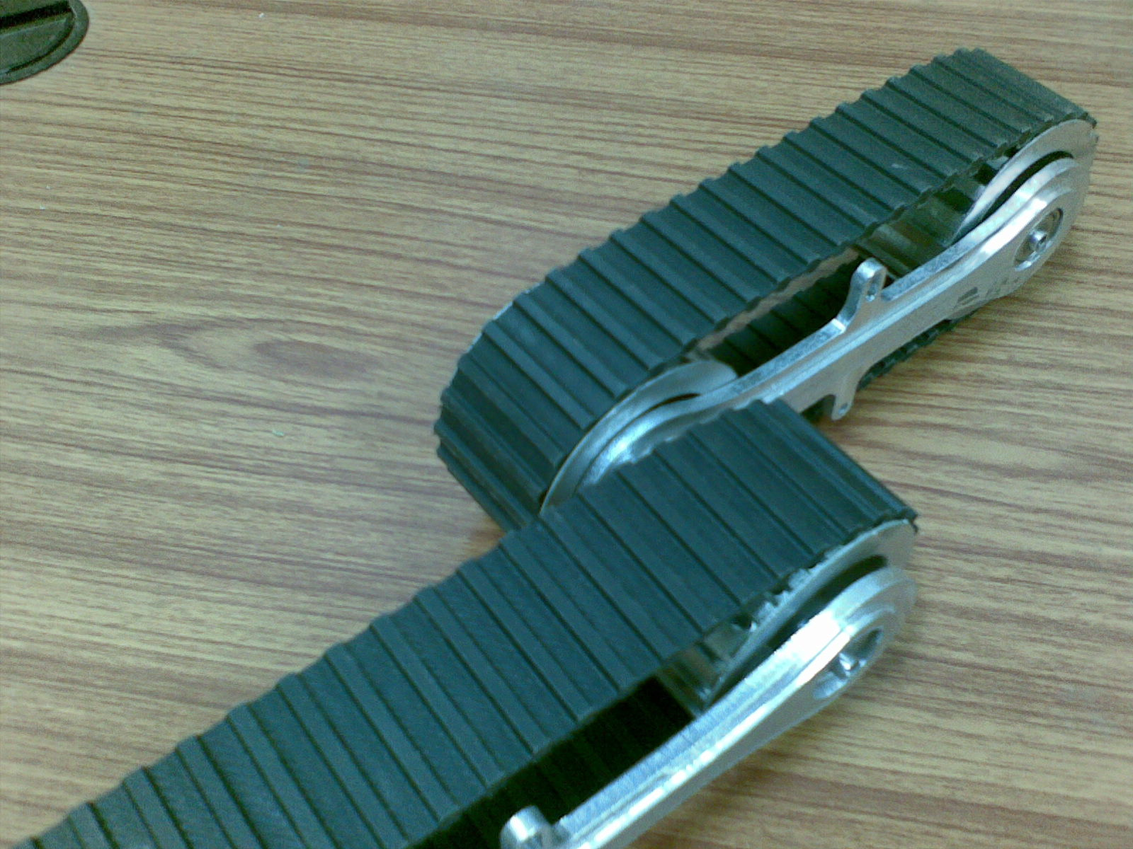
PASSIVE DOUBLE TRACK MECHANISM
Passive joint
A mechanism whereby a single actuator drives a pair of tracks on each side.

Slide 15
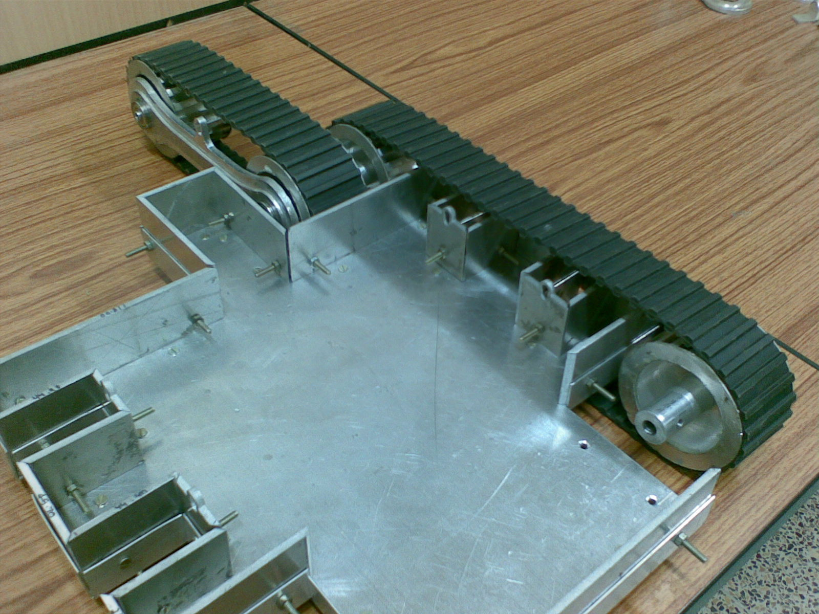
Chassis (Fabricated of Aluminium)
Room for mounting the Motors.

Slide 16
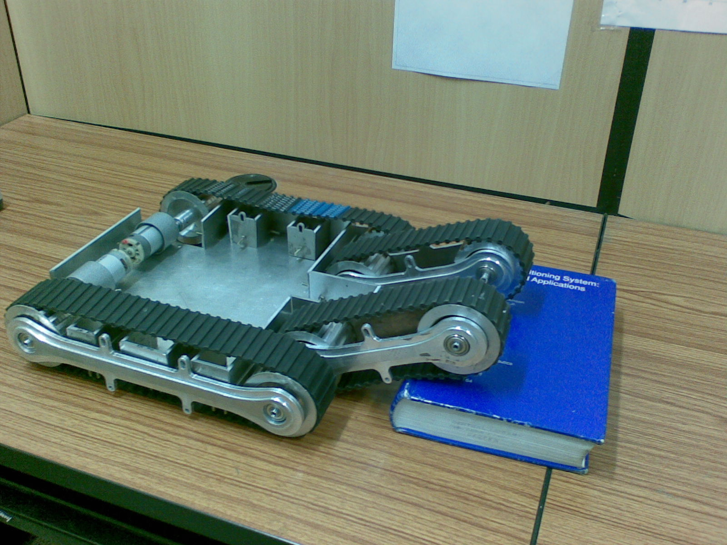
FLIPPER ASSIST MECHANISM
A novel mechanism of changing the footprints of the vehicle to vary the amount of traction needed.
Also act as auxiliary tracks to surmount obstacles when needed.

Slide 17
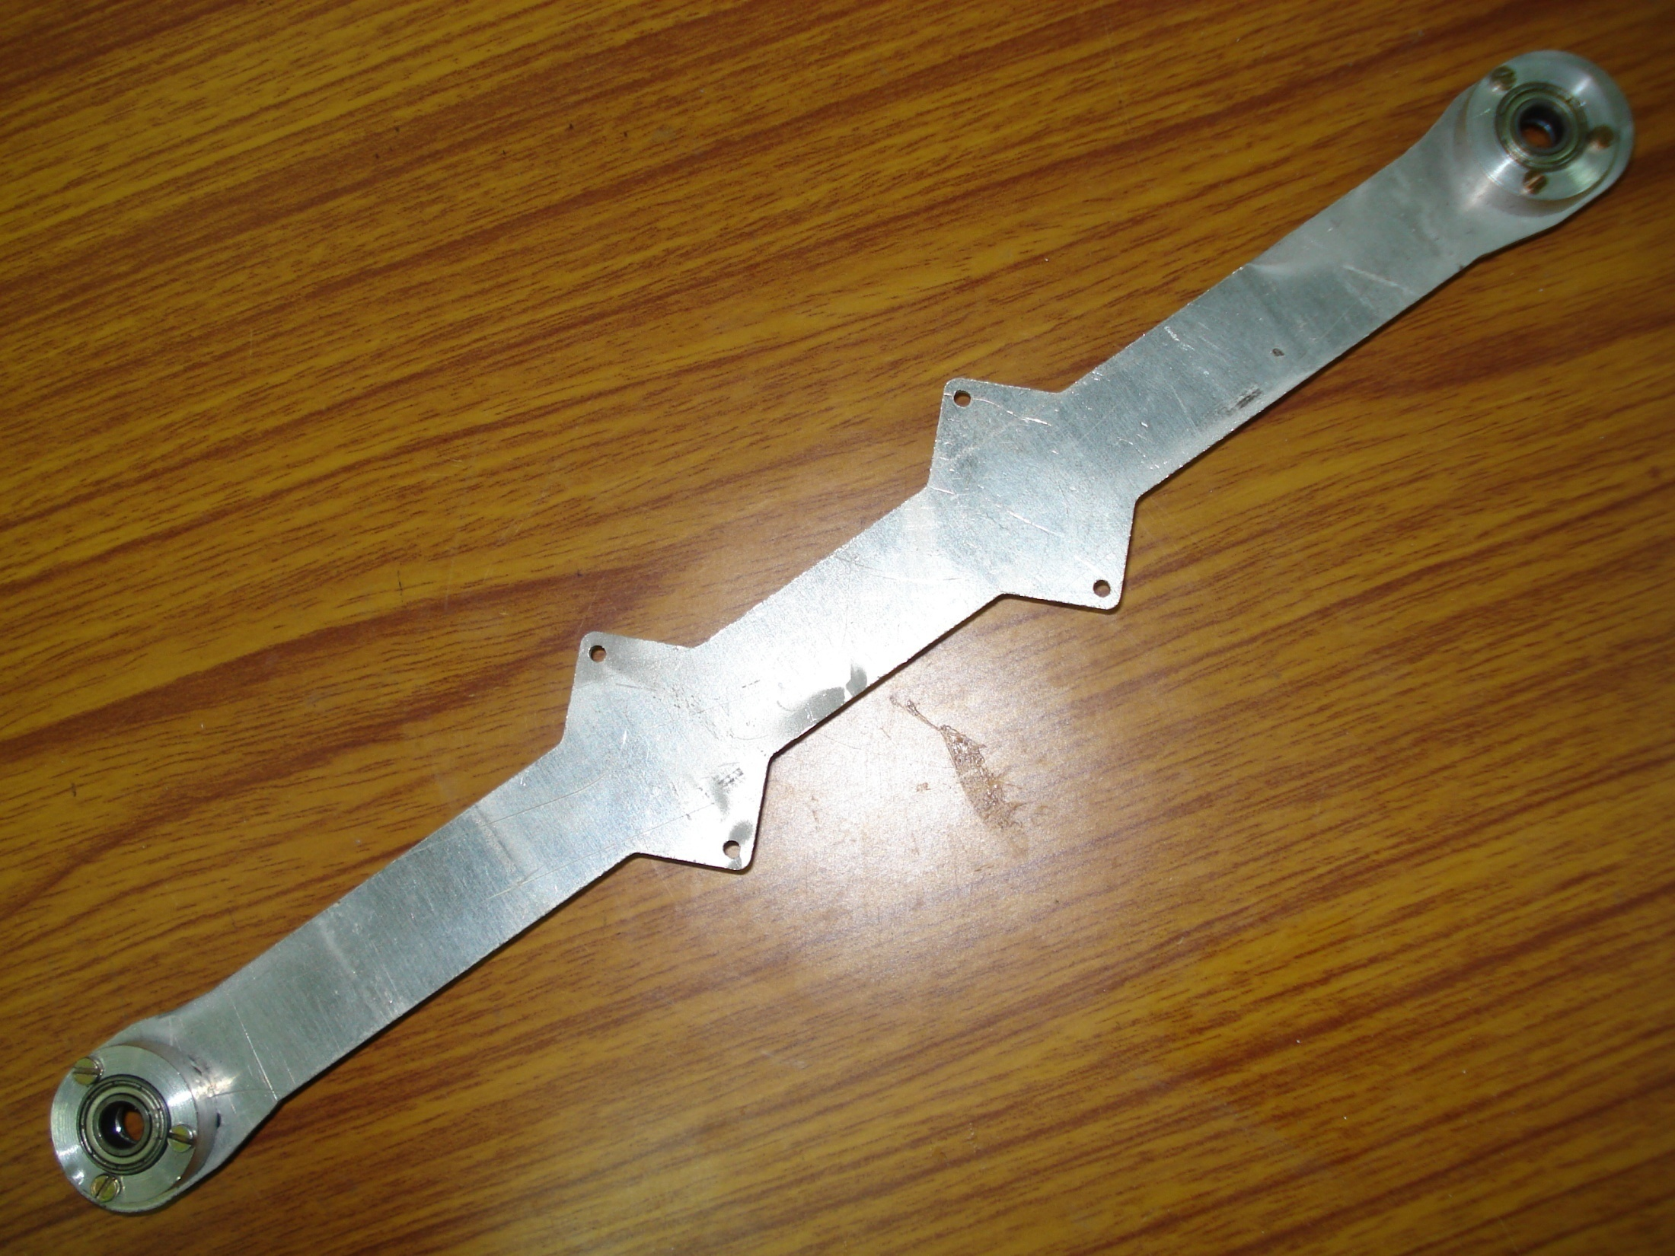
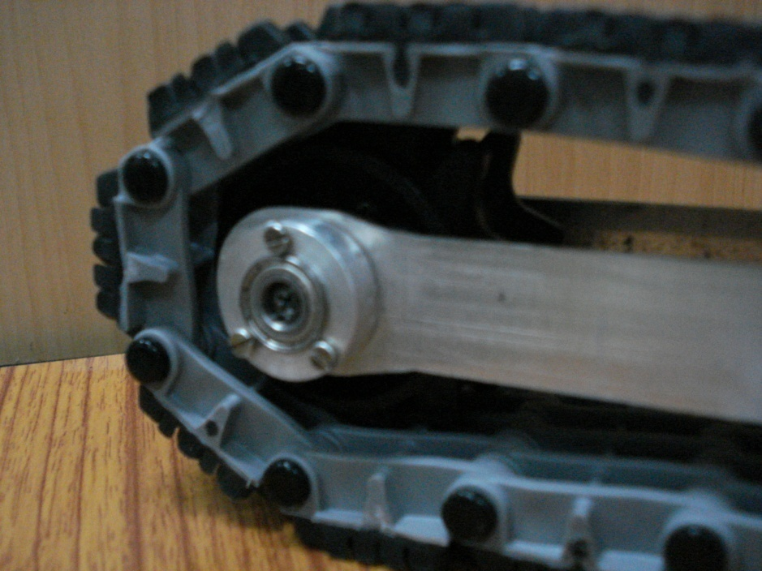
Lighter Aluminium support beams.
Track tension adjustability with Slide bearing housings.

Slide 18
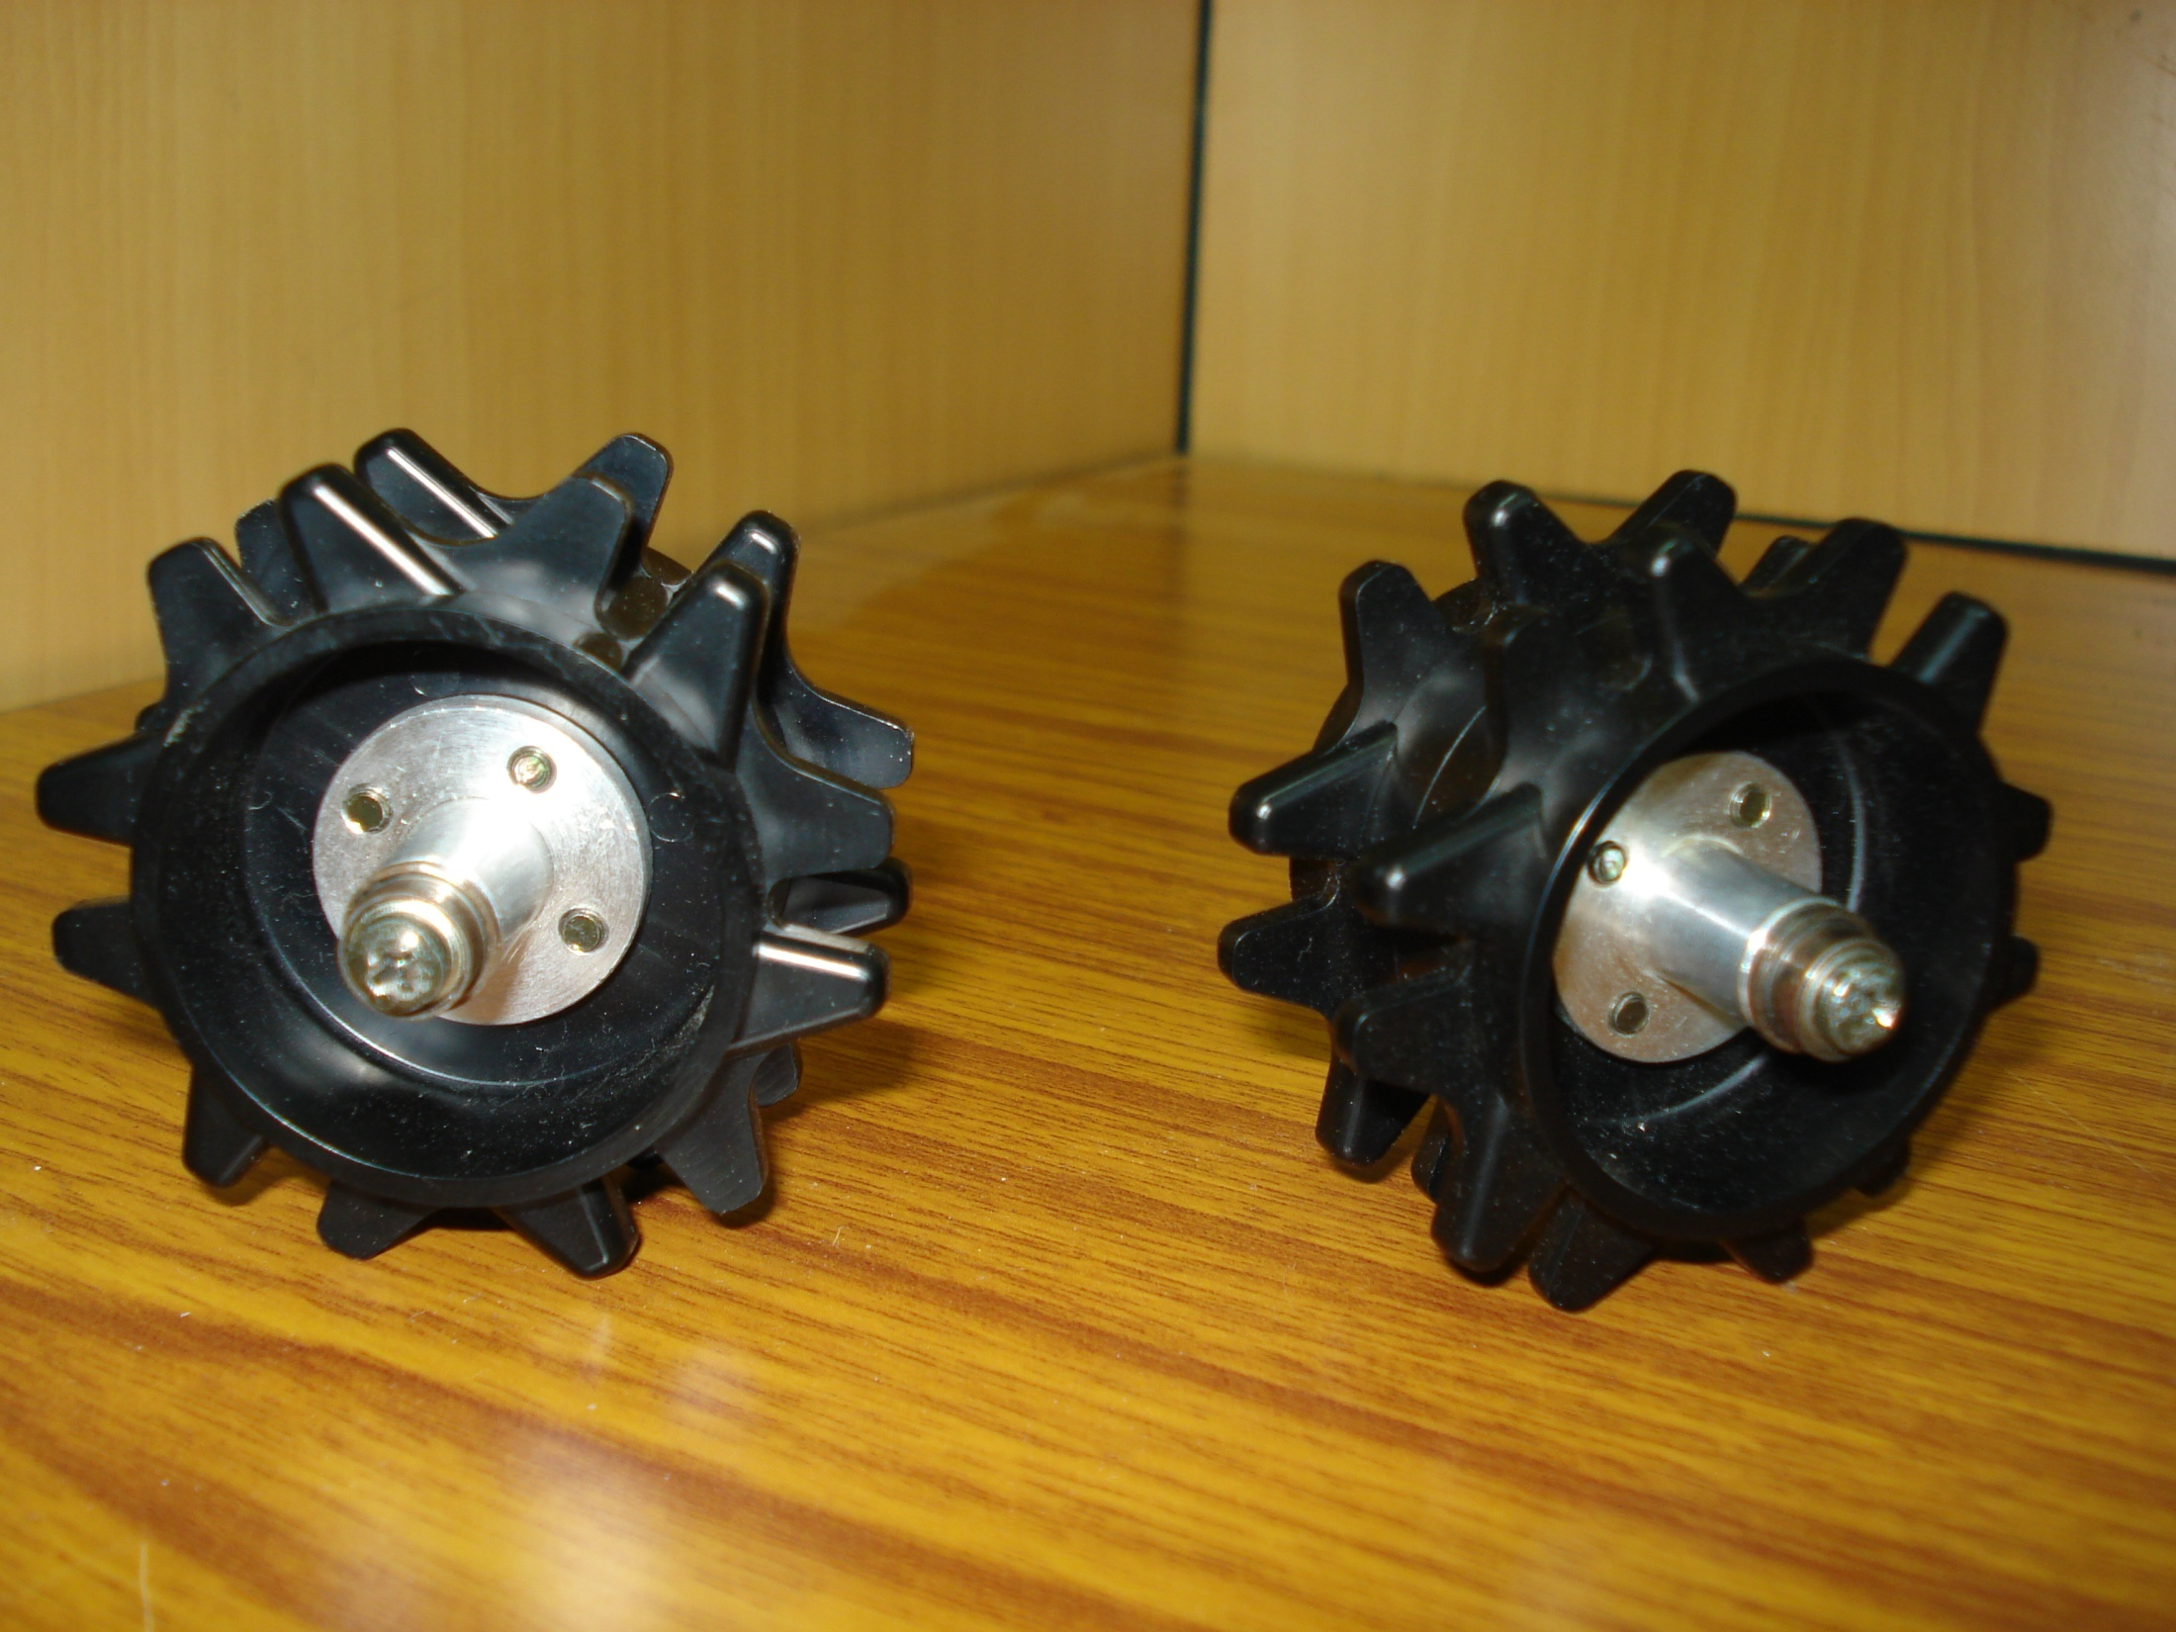
Sprockets with aluminium hubs.

Slide 19
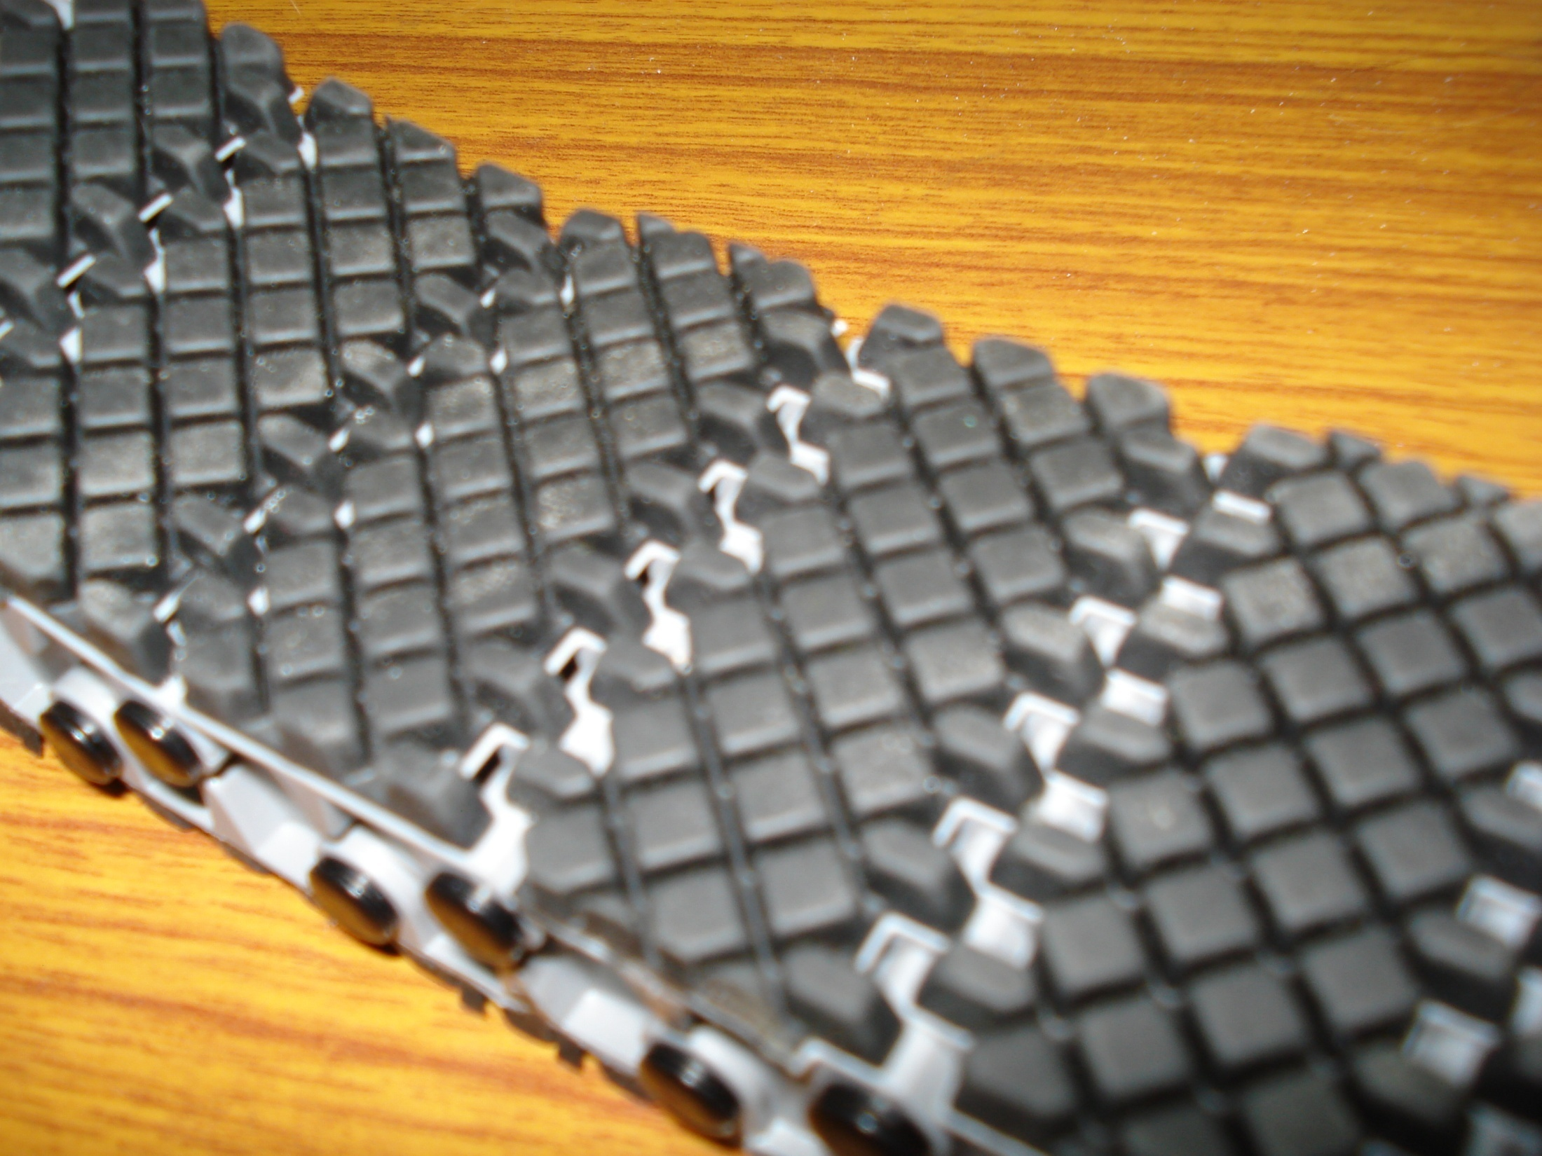
Polypropylene rubber tracks
Robust and light weight.
Rubber pads for enhanced grip.
Composed of individual links appropriate for length setting.

Slide 20
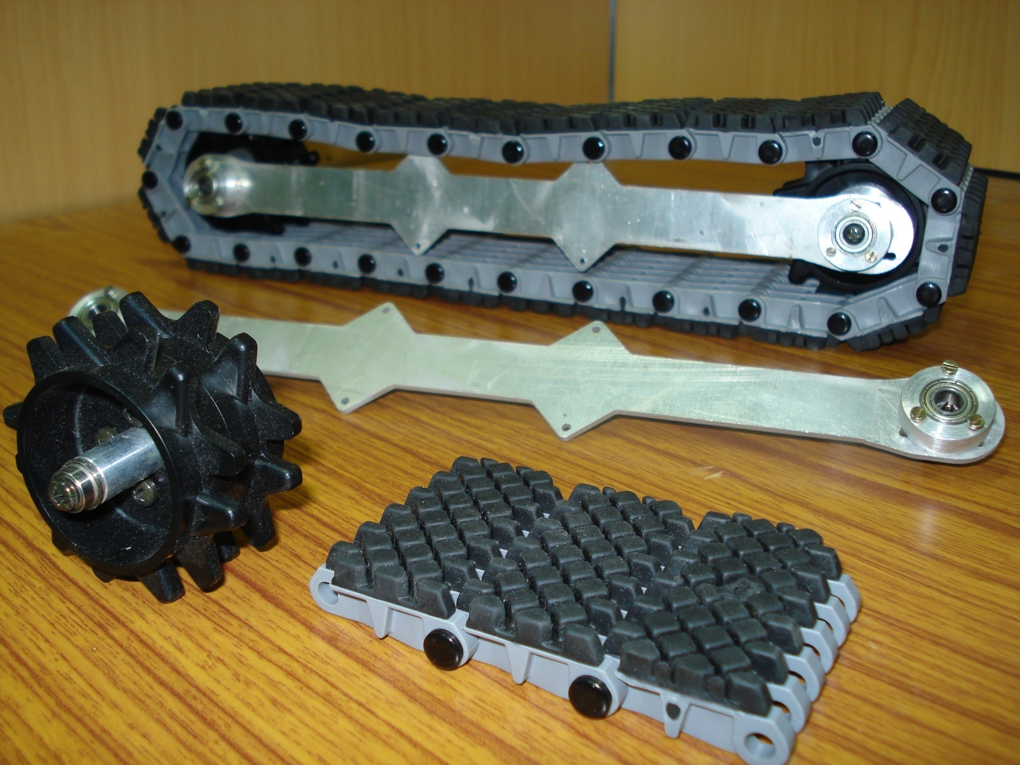
Complete track assembly depicting constituent parts.
Provision to mount additional idler wheels to keep tension and prevent tracks from sagging.

Slide 21
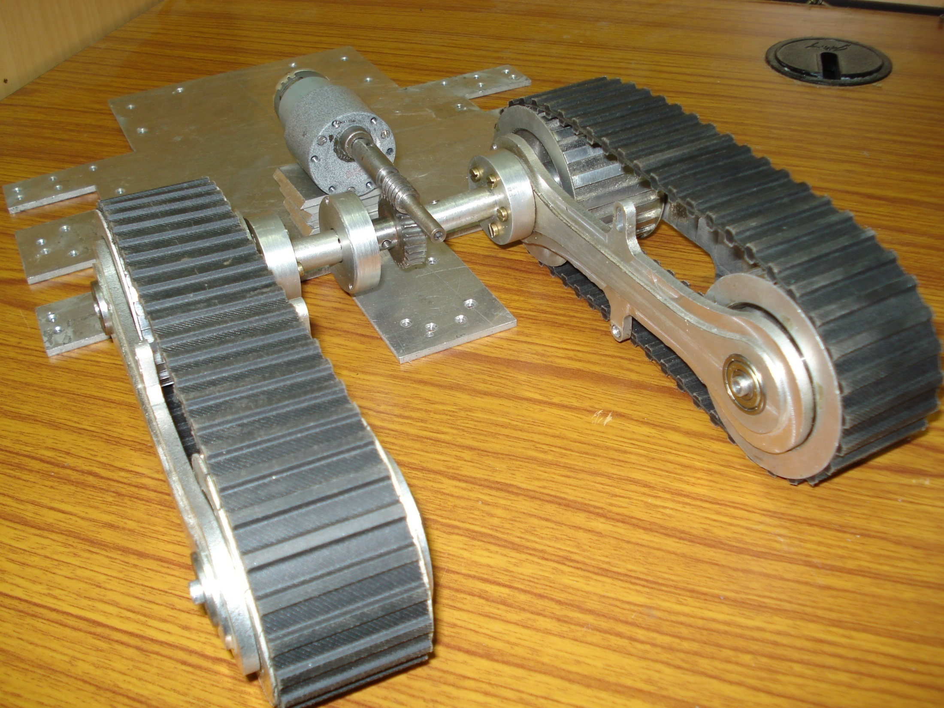
Flipper Assist Mechanism (as to be implemented on the prototype)
Figure Depicting the use of Worm Gear to rotate the “Flipper” tracks.

Slide 22
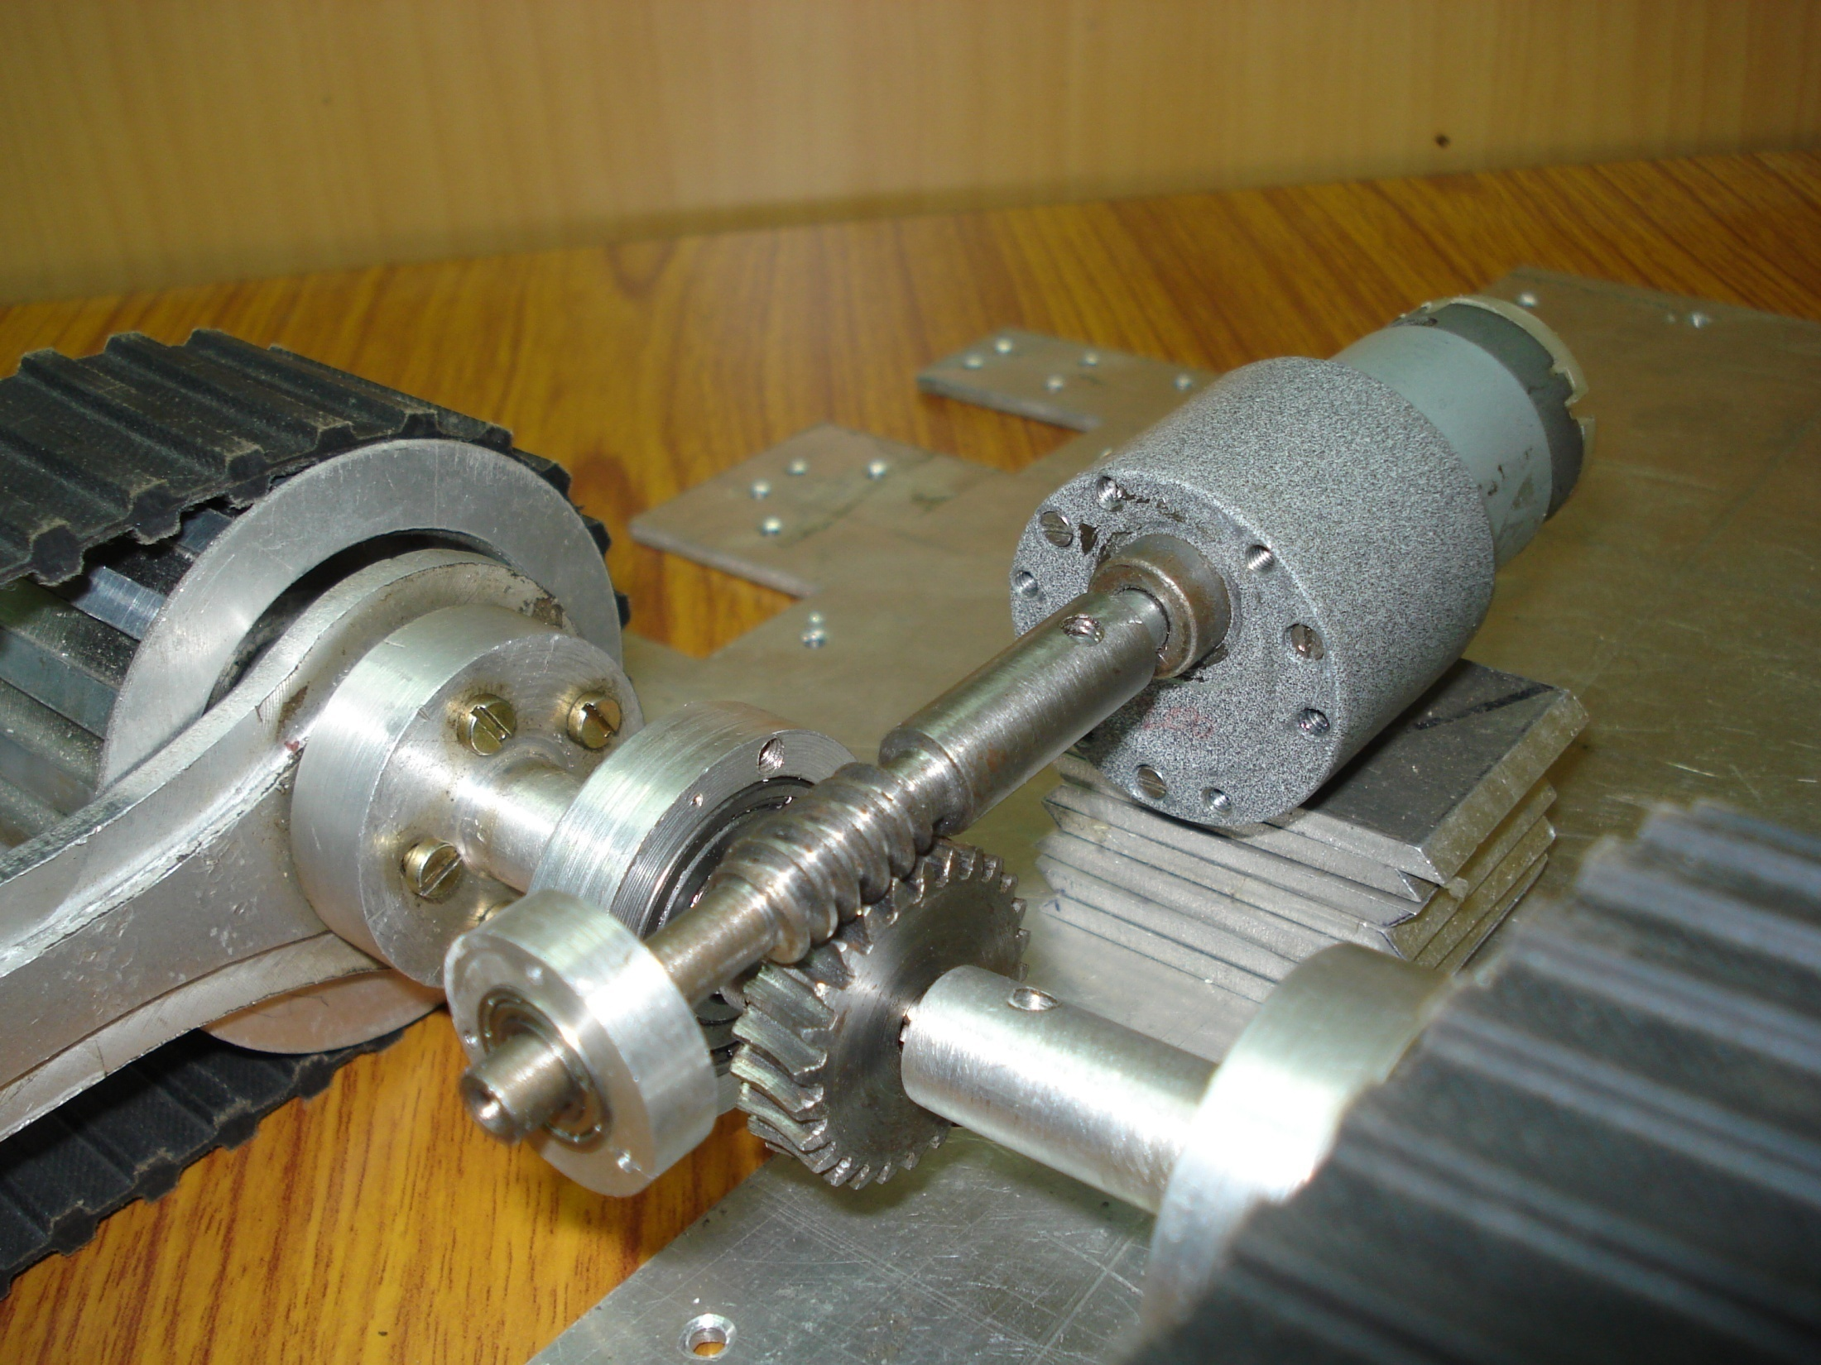
Motor
Flipper tracks
Worm and Work assembly

Slide 23
Navigation and Localization

Slide 24
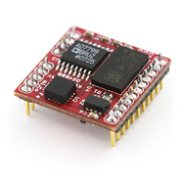
3D COMPASS
Proposed Component :-
OS-5000-US compass
Specifications :-
Provides Roll & Pitch full rotation, typical 1° accuracy <±30° tilt
Pitch Angles +/-90 degrees, Roll Angles +/- 180 degrees
Tiny size, 1”x1”x0.3”, less than 2 grams weight
Interface through RS-232 and USB
Rugged Design :- 10000G Shock Survival
High Data Update Rate to 40HZ

Slide 25
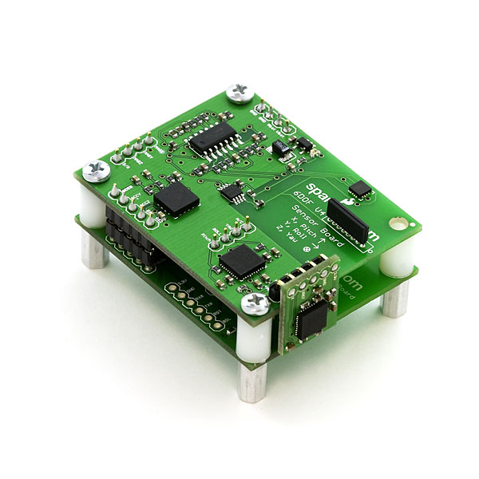
Inertial measurement unit
Proposed component: SEN-08454(IMU 6 degree of freedom)
Features:
Input voltage: 3.7 V to 7 V
LPC2138 ARM7 processor
10 bit ADC
SRAM: 32 kB and Flash: 512kB
3-axis MMA7260Q accelerometer
Range upto +/- 6g
Sensitivity: 200mV/g (for +/6g range )
Two 2-axis IDG300 gyroscope
Range: +/- 500 °/sec
Sensitivity: 2mV/°/sec
Minimum acceleration reading: 5 mg
Minimum rate reading: 0.5 °/sec

Slide 26
Error Analysis
Sensor Errors:-
δwx=b+bg*[ax ay az] + sf*wx+my*wy+mz*wz+η
Δfx=b+sf*ax+my*ay+mz*az+η
b=Residual bias
bg=g dependent bias coefficient
sf=Scale factor
m=Mounting and internal misalignments
η=Random noise
G independent fixed Bias removed as discussed.
Temperature correlation of bias removed by on the run bias removing method.
Scale factor error in accelerometers removed by equating the net static reading to gravity while static testing.
Rate Table test-Internal misalignment error.
Scale factor error in gyros removed by keeping axis parallel to rate table and cycling rate table from maximum to stationary rotation rates.
White noise integration (Random Walk) causes error growth in random direction.
Alignment Techniques used by us:-
Coarse initial alignment obtained using constant g when vehicle is static.
Digital Compass readings used to determine initial Euler angles.

Slide 27
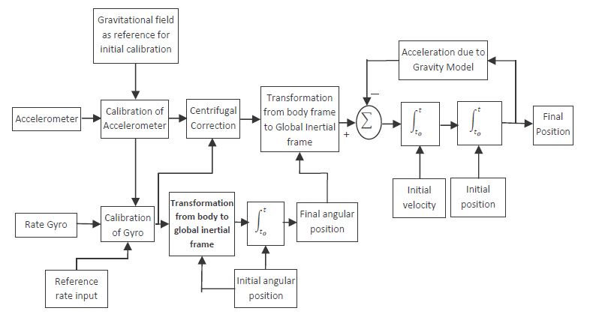
Inertial Navigation System
Strapdown System Block Diagram for Navigation
Reference:-

Slide 28
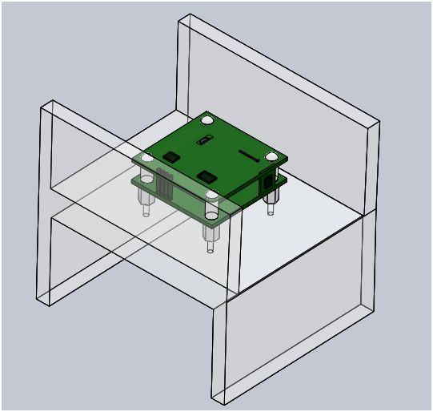
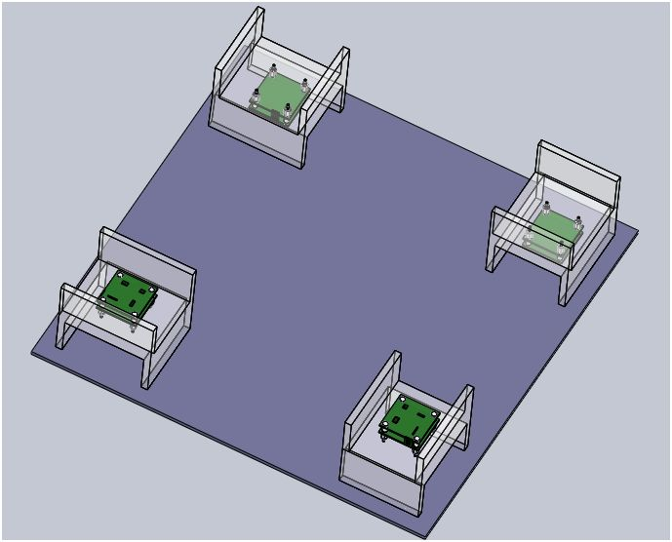
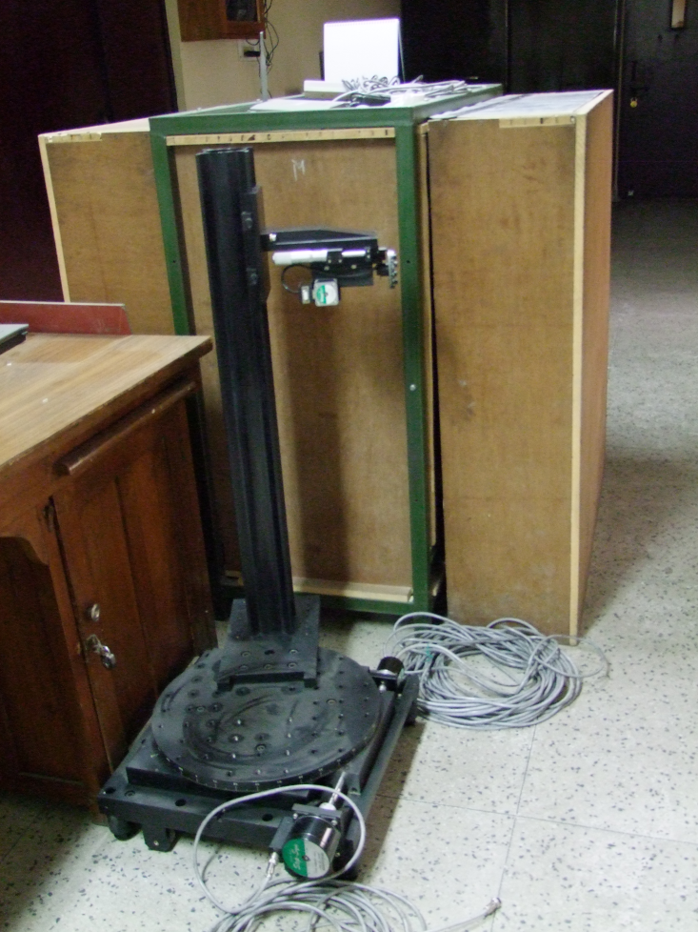
Test Setup
Chloroform welded Acrylic Test set up-Good surface finish tolerance obtained by water jet cutting.
Connectors position,Tight mounting considered for Mount design.

Slide 29
Bias
Sensor Output 1=Bias1 + g*sinθ1+Cross Axis coupling error
Sensor Output 2=Bias2- g*sinθ1-Cross Axis coupling error
Sensor Output 3=Bias3+ g*sinθ2+Cross Axis coupling error
Sensor Output 4=Bias4- g*sinθ2-Cross Axis coupling error
Accelerometer Bias=(Output1+Output2+Output3+Output4)/4
Gyro Bias=(Output1+Output2+Output3+Output4+Output5+Output6)/6

Slide 30
Methodology for Bias Removal
Coarse Testing
Static Testing
Dynamic Testing
Data Averaging
Static Readings for all positions averaged for a particular frequency
Removal of errors due to noise expected .
Allan Variance curve
Graph of Standard deviation of Bias versus Averaging Value plotted
The stable value of Averaging value taken to find the static bias.
Average Bias Curve
Initial values of IMU erroneous as seen by average bias curve.
Readings considered for averaging after average bias stabilization.

Slide 31
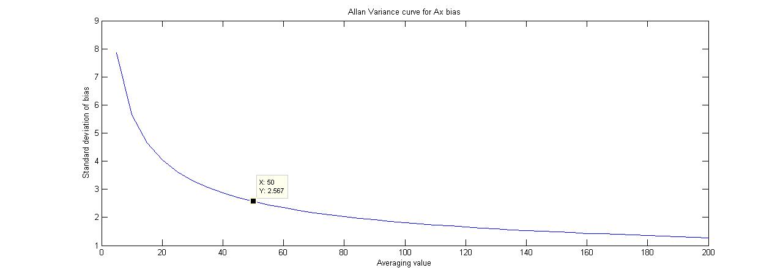
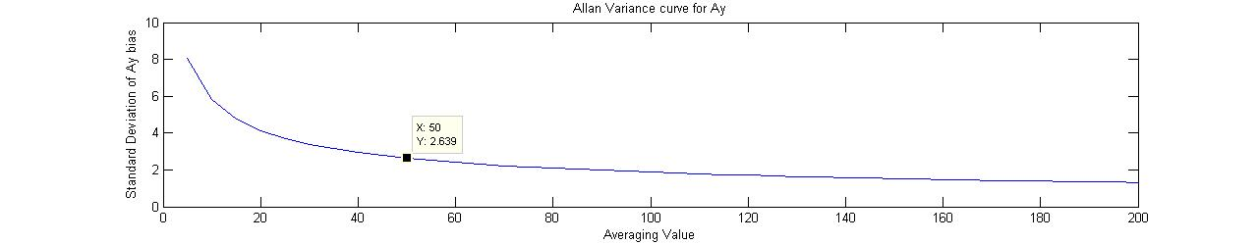
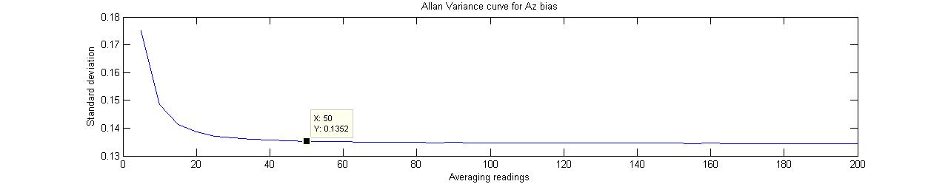
Results

Slide 32
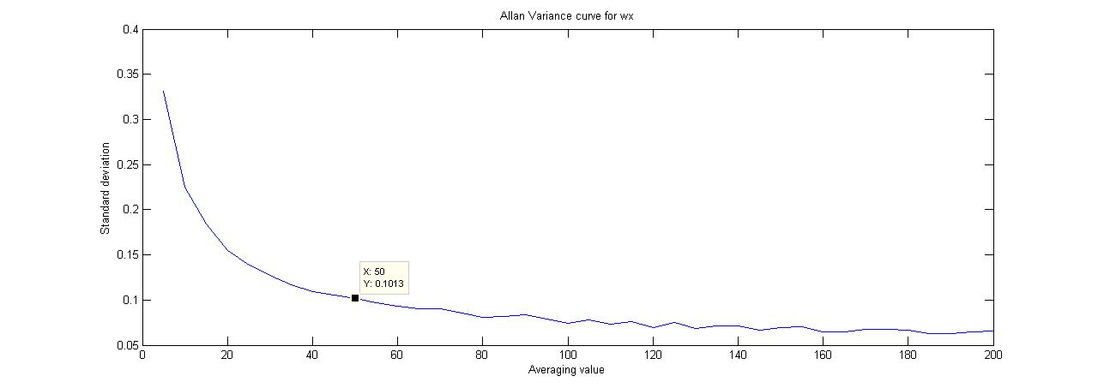
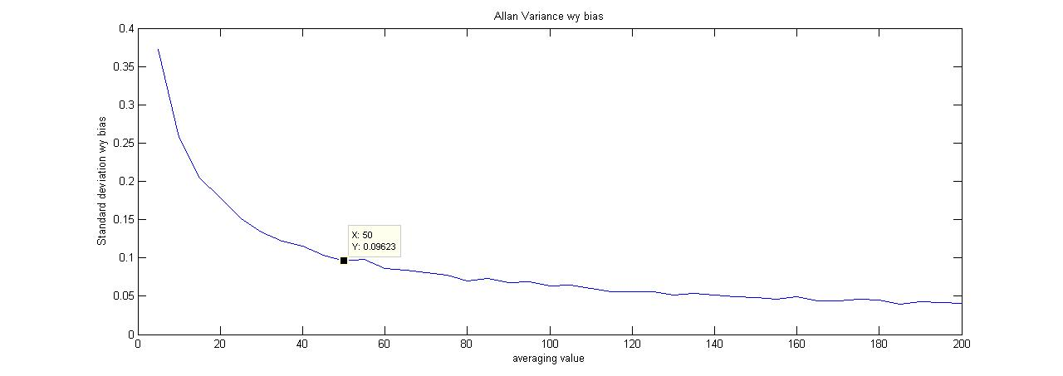
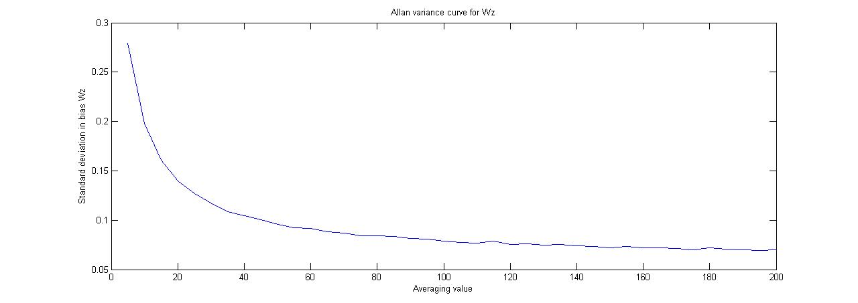

Slide 33
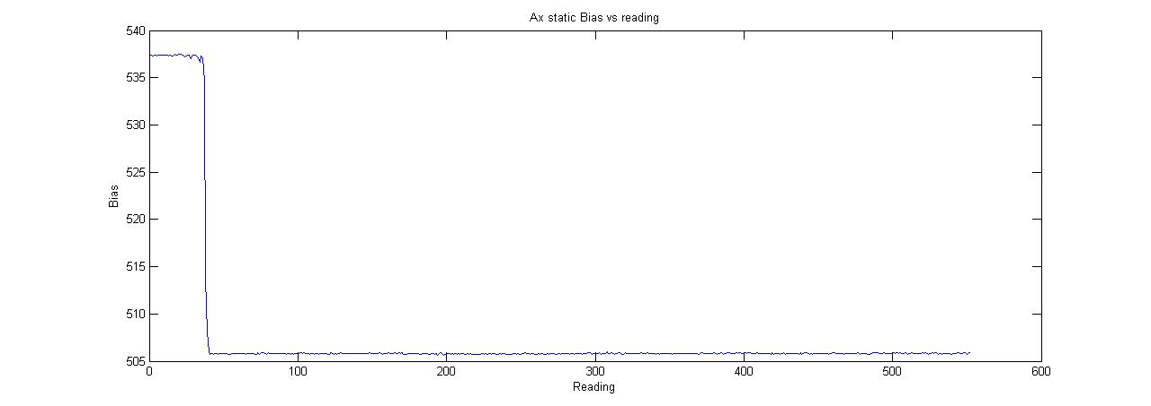
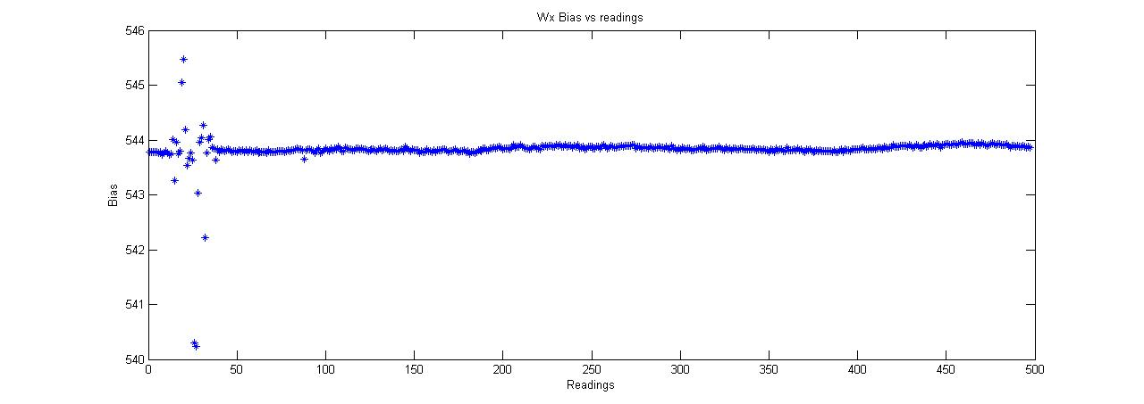
Instantaneous Bias Plots

Slide 34
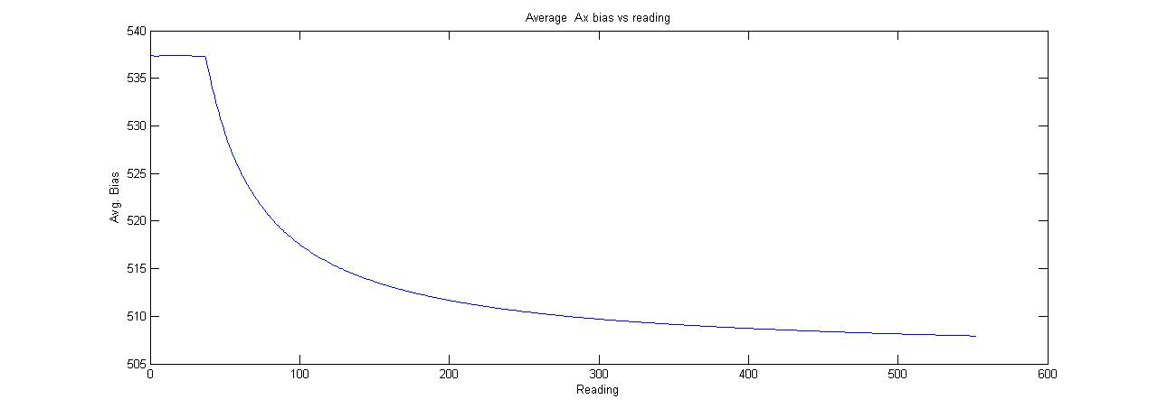
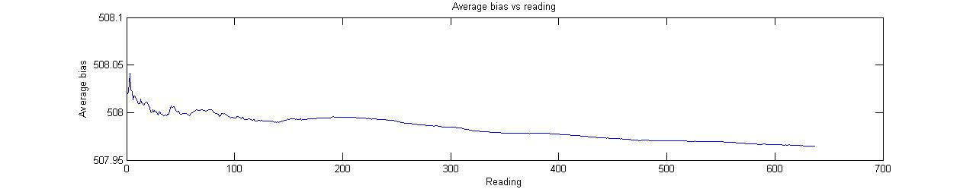
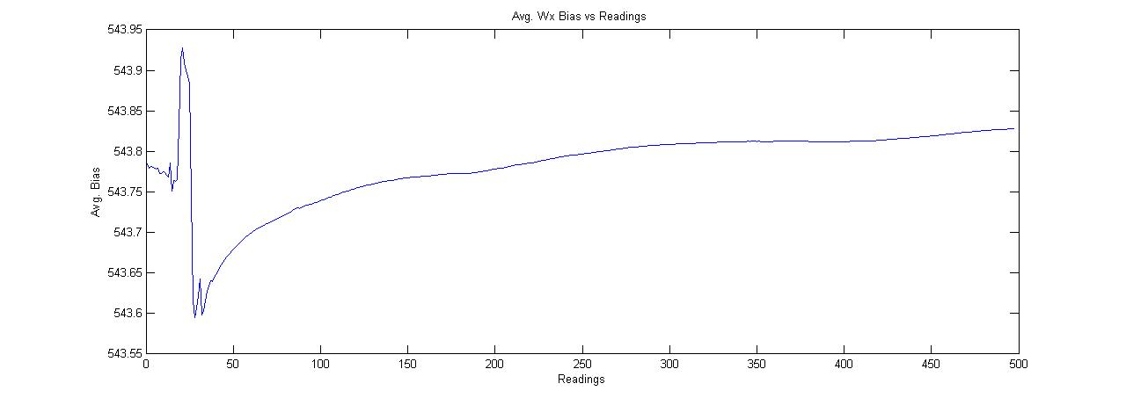
Average Bias Plots

Slide 35
Static Testing:Summary of Inertial Sensor Errors
Errors | Deterministic | Random | Calibration | Compensation | Stochastic Modeling
Bias Offset | Yes |  | Yes
Bias Drift |  | Yes |  |  | Yes
Scale Factor | Yes |  | Yes
Misalignment | Yes | Yes |  | Yes | Yes
Noise |  | Yes |  |  | Yes

Slide 36
Calibration methods and Techniques
Six-Point static and rate tests(Titterton and Weston 1997)
Multipoint Calibration Method(Shin and El-Sheimy 2002)
Modified Multipoint Calibration Method(Syed and Aggarwal 2007)

Slide 37
Stochastic Modeling Techniques
Adaptive Kalman Filter
Fast-Fourier Transform
Wavelet-Nosing Method
Allan Variance Method (Easy to Apply)

Slide 38
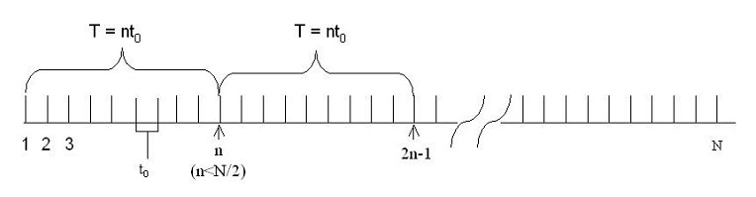
Allan Variance : Methodology

Slide 39
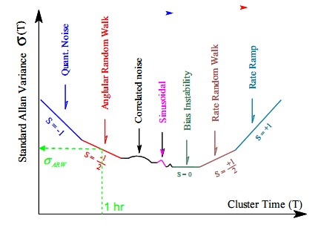
Typical Allan Variance Curve

Slide 40

Results : Accelerometer(X)

Slide 41

Results : Accelerometer(Y)

Slide 42

Results : Accelerometer(Z)

Slide 43

Results : Gyro(X)

Slide 44

Results : Gyro(Y)

Slide 45

Results : Gyro(Z)

Slide 46
Inertial Navigation
Frame of Reference:-The Earth Frame/NED frame.
Considerations:-
Coriolis force on moving vehicle due to rotation of earth
Accelerometer measures acceleration in body frame while gyros measure total inertial rotation(rotation of earth wrt to inertial frame also)
f(e)=C*f(b)
Euler Representation
Pitch,Roll ,Yaw updated via integration.Rotation matrices product gives E(n,b)
Computationally expensive and singularity at Pitch=∏/2.
DCM Representation
Uses skew symmetric matrix(Ω(b,n)) of gyro readings.
Quaternion Representation
Computationally least expensive.
Computationally less expensive
C’(n,b)=C(n,b)*Ω(b,n) discretised to obtain it
Uses 4 parameters with no physical meaning.
Reference:-

Slide 47





Kalman Filter
Predictor and corrector type estimator that calculates the state of the system in a recursive manner.
is state vector at time instant t(k)
A is state transition matrix
Is state vector at time t(k-1)
is input to system
Process noise covariance matrix
H is observation matrix
Measurement noise covariance matrix

Slide 48

Preliminary State model
State model developed for continuous coordinate transformation from body frame into NED frame and state model for position ,velocity ,pitch,roll and yaw made.
Matrix augmented to include more variables (Bias Predictions) to be calculated by the state model.The conditions of Observability checked.
Matrix discretization.Kalman equations applied on the state model taking GPS + Compass Readings as measurements and calculating the various error model matrices.
If observability condition fails
Non linear state model with update matrices functions of sine/cosine of angles.
Extended Kalman Filter Model applied requiring the continuous updation of all matrices on every reading of IMU.Required calculation of jacobian of matrices.
Method dropped –Computationally very expensive.

Slide 49

GPS-INS INTEGRATION
Linear direct feedback filter implemented.Octave code written.
State vector comprises of errors in estimation of position, velocity and angle.
ŝ(k|k-1)=F(k)*ŝ(k-1|k-1)
State prediction is always zero but drift in INS solution evaluated via predicted covariance matrix P(k|k-1)
Process noise matrix Q(k) evaluated by IMU sensors noise values (manufacturers specifications) or experimentation
GPS observations used as measurements.
The DCM is updated rather than updating the angles using the misalignment errors.
References:-
Aided INS for autonomous land vehicles-Salah Sukkarieh.
GPS INS Integration-Jay A Farrell
Global positioning system,Inertial navigation & Integration-MS Grewal
Field Evaluation of a Low-Cost Strapdown IMU by means GPS
RAUL DOROBANTU*) AND BENEDIKT ZEBHAUSER*)

Slide 50

INS-GPS Integration algorithm

Slide 51


Slide 52


Slide 53

This algorithm is preferred to the EKF model due to lesser computation.
It is a linear model with IMU integration errors bounded.

Slide 54

Global Positioning System
Tasks Achieved
Satellite transmits messages containing
Sending time
Orbital information
Receiver
Measures the transit time of each message
Computes the distance to each satellite.
Combines these distances with the location of the satellites to determine the receiver's location using geometric trilalteration
Specifications:-
Number of channels: 12
Frequency 1Hz
Position accuracy: 2m
Baud Rate: 4800bps (optional 9600, 19300,38400)
Interface: RS232/TTL
Acquiring of NMEA data in RAW/SMART mode
Interfacing with PCs and Beagle board
Data acquired in open environment
Data consistency checked by Google Earth Maps.
Filtering of GPS data by constant velocity model

Slide 55

$GPGGA: Position Response Message
$GPGSA: Satellite Used Response Message
$GPRMC: Recommended Minimum Course Response Message
$GPGSV: Satellites-in-View Response Message

Slide 56


GPS Testing+Errors
GPS fix in vertical plane less accurate due to satellite geometry hence observation noise matrix R(k) has different noise terms.
DOP values obtained will be used to filter GPS readings.
The filters will be optimised so that the lag between estimation stages of Kalman filter are small else uncertainty in INS solution grows large.
In open environment our field testing estimated the accuracy ~ 2m.
We are operating the GPS in smart mode for lesser computation.
WGS ECEF NED frame transformation
Our GPS log values plot on Google Earth satellite view of IITK Campus

Slide 57

Laser Scanner
Consists of a LASER rangefinder in a rotating mirror assembly
Proposed Component :- Hokoyu URG-04LX
Specifications :-
Gives data with pencil beam viewing at high data rates(38.4 K baud or more)
Has an embedded processor which packages data for the host computer
Range- approx. 0.02 to 4m(depends on reflecting surface)
Scanning Area-240 degrees
High Accuracy-10 mm
Resolution-0.36 degrees

Slide 58

Feature Extraction and Association
Consists of chalking out a strategy for effective terrain traversal
Uses the Laser Scanner to discriminate between drivable and non-drivable terrain
Discrimination is done by extracting the features of the environment pertinent for navigation

Slide 59
Landmark Extraction
Obstacle Linear Approximation
Each obstacle is approximated by a linear obstacle with its corners as end points.
Breakaway points are initially found. They are points where a large discontinuity occurs in distance plot of obstacle points.
Spike Landmarks
Spike landmarks are extracted
They are points where the summation of difference between distances of 3 consecutive points is a finite value.
Geometrical Figure extraction
Geometrical figures like Straight line walls are extracted from the given data
Mainly we applied the algorithm of slope of neighboring points lying within a range of the previous slopes. Best fit line is approximated.
Any 2 neighboring breakaway points are ends of an obstacle or gap .Obstacles and gaps occur alternately.
This method will be applied for implementing SLAM(Simultaneous Localization and mapping) in environments where landscape changes a lot.
This helps us to smoothly travel by wall following in clean environments with well defined walls.

Slide 60
Navigation Algorithm
Laser Scanner data converted to polar coordinates.
Breakaway Points calculated.
Each significant discontinuity in (r,θ) plot taken as a pair of breakaway points.
Alternate pairs of breakaway points are obstacles.
Each obstacle taken as a linear obstacle with breakaway points as its upper and lower bound. It helps in saving computation power and serves as a reasonable approximation for movement of robot since only gaps are navigations main priority.
Robot prefers minimum turning to reach the Required heading as well as it wants to go through a gap closest to required heading. Each gap is allotted a GapDir (the angular direction through which the robot may pass for minimum time if it goes through that gap) and Preference value.
Preference value= Constant(Reqth-GapDir)+ GapDir
Only those gaps considered whose angular width of upper and lower bounds or only upper bound width is more than Robot width + Clearance .
The robot moves through the gap with maximum Preference value.
If no gap available then all obstacles projected on a unit circle and robot moves towards smallest pseudo obstacle.

Slide 61

Navigation Algorithm

Slide 62

Navigation Algorithm
Case 2:-Obstacle moves in the direction of required heading
Required Heading
Case3:-Robot moves in a direction just avoiding the obstacle end closer to Required Heading
Case 1:-Obstacle moves to avoid collision with closer obstacle and ensures it will pass through larger gap

Slide 63

IMMEDIATE Obstacle Avoidance
Required to provide protection to the vehicle from collisions from objects that may have been overlooked by the laser sensor
Uses IR sensors at carefully placed positions on the vehicle
Proposed Sensor :- SHARP GP2D12 distance measuring sensor
Distance measuring range- 10 to 80 cm

Slide 64
Navigation Technique
“Subsumption Technique” will be used for navigation
Highest Priority
Escape maneuvers
Collision Avoidance and Path planning
Navigation towards target location
Lowest Priority
Escape maneuvering:- Vehicle will try to escape when it gets stuck.
In case if the vehicle can’t get unstuck then it will SMS its location to the user and stop all other processes.
Collision Avoidance:- It will navigate through the path avoiding the obstacles based upon the sensor output. Standard algorithms are available for path planning.

Slide 65

ON BOARD COMPUTER

Slide 66


Slide 67


Slide 68
Main Functions of OBC
To assess the obstacle profile as provided by the laser scanner and IR sensors and avoid obstacles accordingly.
To plan the Shortest and most optimized pathway to the destination based on minimum time and minimum turning.
To calculate the position,velocity and pitch roll yaw from the IMU readings and give a accurate position through Kalman filter model applied on INS assisted by Compass and GPS.
To implement motor control system through feedback with Encoder.
To communicate the position, orientation, locomotion and health data to the controller unit through GSM.
To implement preference order to different subsystems.

Slide 69
Functional Cycle
Vehicle Static-GSM activated.IMU bias calibration done.
Filter values initialized –GPS
+ Compass
Obstacle Detection+
Collision avoidance+
Path planning.
INS + Filter activated
GPS/Compass values used.
Health monitoring+Imaging

Slide 70
C
H
A
L
L
E
N
G
E
S
Tough
Terrain
Safe Navigation Path
Planning
ABHYAST
Size,
weight and
Power
Self
Localization
Reliable
communication
Computation
Data
Handling

Slide 71
System Overview
Abhyast mass ~5kg
Abhyast Dimensions 30cm x 30cm x 15cm
OBC BEAGLE BOARD
600 MHz,256 MB RAM & 128 MB Flash
GSM board GSM unit,Simmortal Ltd,SIDBI
Laser Scanner R283-HOKUYO-LASER1 Detectable distance : 0.02 to 4m
IR Sensor SHARP Distance Measuring Sensor Unit
GPS PARALLAX Accuracy:~2m
IMU Sparkfun IMU with 6 Degree of freedom
Digital Compass Ocean Server Accuracy – 0.5 degrees
Motors High Torque Maxon Motors with encoders
Camera OMNIVISION Colour Camera

Slide 72


Slide 73
Future Directions
Disaster Management:-
Improvement:-Satellite Phone , Robust Structure
Improved Path Planning with SLAM and Global map making implemented.

Slide 74
Thank You

