Slide 1
Online Account Opening Procedure

Slide 3
Online Account Opening Procedure
Customer can open Saving General Account, Union Digital Saving Account and SB Pension Account through Online.
Link for online account opening is given in our Corporate website as well as in Umobile.
Umobile Link directly redirect you our Corporate website Online Saving Account opening page.
When we click on apply online saving account, following page will appear:

Slide 4
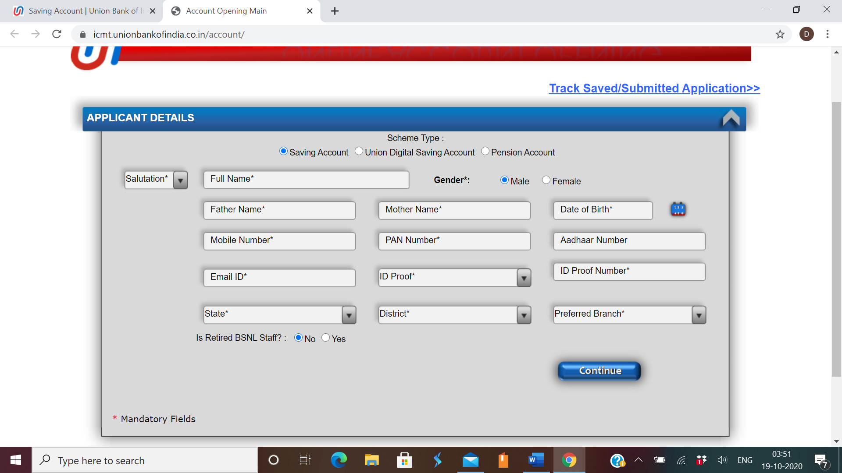

Slide 5
PAN NO, E-mail ID and Mobile no are mandatory for online account opening. Customer need to fill all the mandatory fields.
After filling all the details and selecting the Branch in which customer want to open account, 2 different OTP received by the customer on mobile no and mail ID.
After filling both the OTP following page will appear-

Slide 7
After filling address and other detail and click on continue, following page will appears:

Slide 9
Now online application submitted successfully, and a unique reference no is generated. Customer get a confirmation mail with reference no and details of completing the process of online account opening.
When customer get the reference no same reference no is reflected in the selected branch SOL in OLACOPN menu on real time basis.
Now customer has to visit the branch with 2 photographs and KYC documents within 30 days for completing the process of account opening.
If you cannot visit the branch, download the form, print it out, sign every page on the bottom and send it via post along with the following documents:

Slide 10
Documents: PAN, Aadhar, Photo (3), Signature on every page of the printout, Proof of bona-fide of student in IIT Kanpur (all documents should be self attested).
Address for posting these along with the application form :
Union Bank Of India
IIT Campus
IIT Kanpur, 208016

